Slide 1
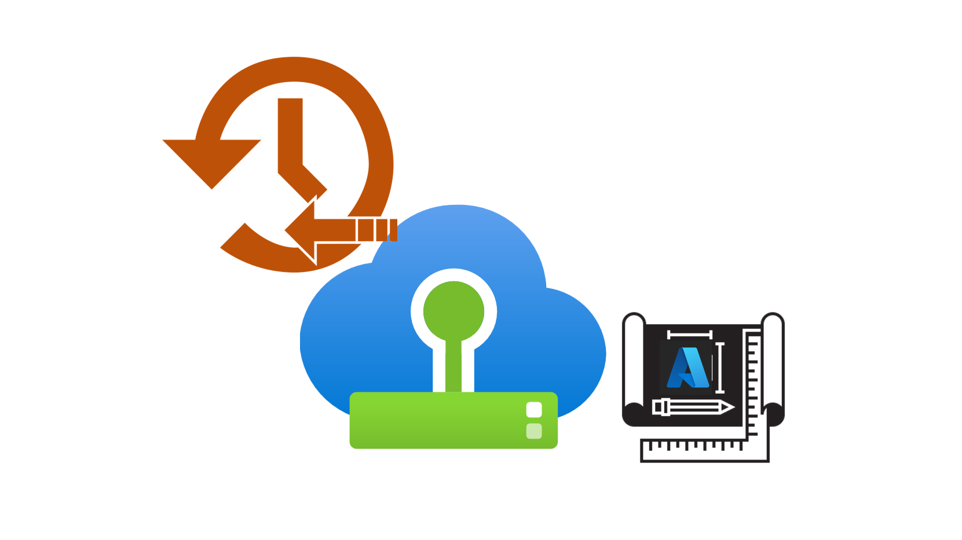
Azure VMware Solution Recoverability Design Considerations Template

Slide 2
MTD
Consistent Production Data
Disaster Strikes
Systems Recovered
Service Resumes
RPO
RTO
WRT
Time (Minutes, Hours, Days, Weeks, Months)
Figure 1 – Recoverability Concepts

Slide 3


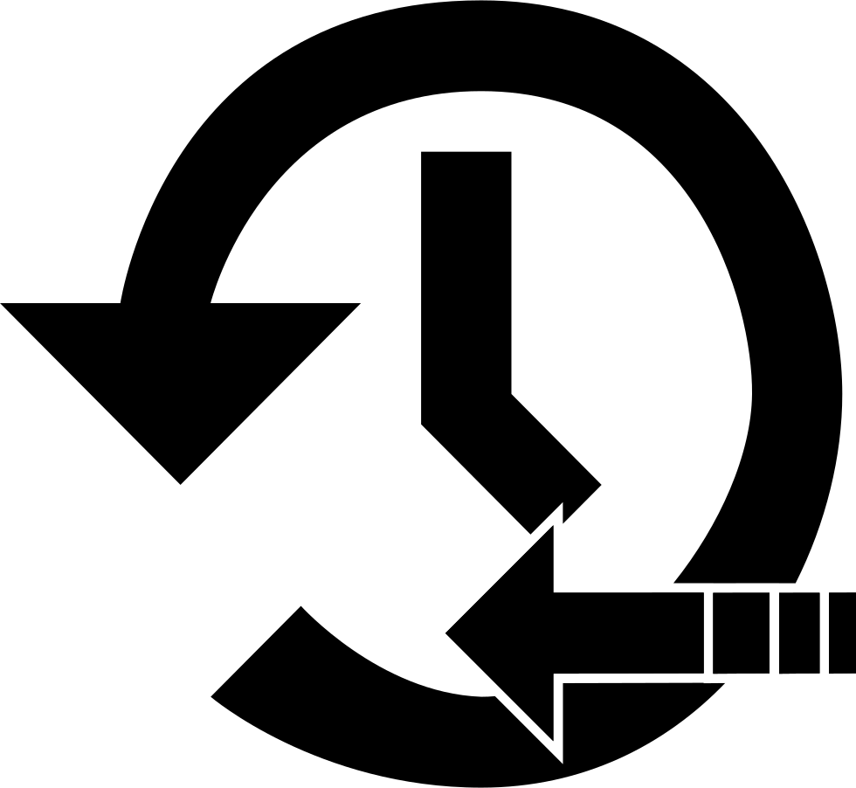
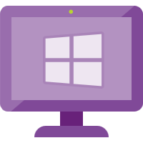
Users
Traffic Flow
Load Balancer Layer
LB 1
LB 2
Disaster Recovery Automation
with Power-On/Power-Off/Switchover/Failover/Failback scripts
DR LB 1
DR LB 2
Web Layer
Web 1
Web 2
Web 3
DR Web 1
DR Web 2
DR Web 3
App Layer
Application, Database, Message Bus, Storage, Backup/Recovery Replication/Clustering
App 1
App 2
App 3
DR App 1
DR App 2
DR App 3
Database Layer
DB 1
(R/W)
DB 2
(R)
DB 3
(R)
DR DB 1
DR DB 2
DR DB 3
Primary Site
Disaster Recovery Site
(typically, 300+ miles away)
Figure 2 – Typical Legacy Business-Critical Application Architecture

Slide 4


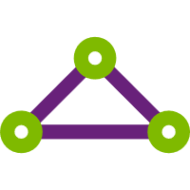





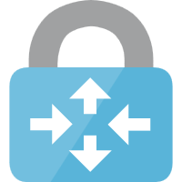

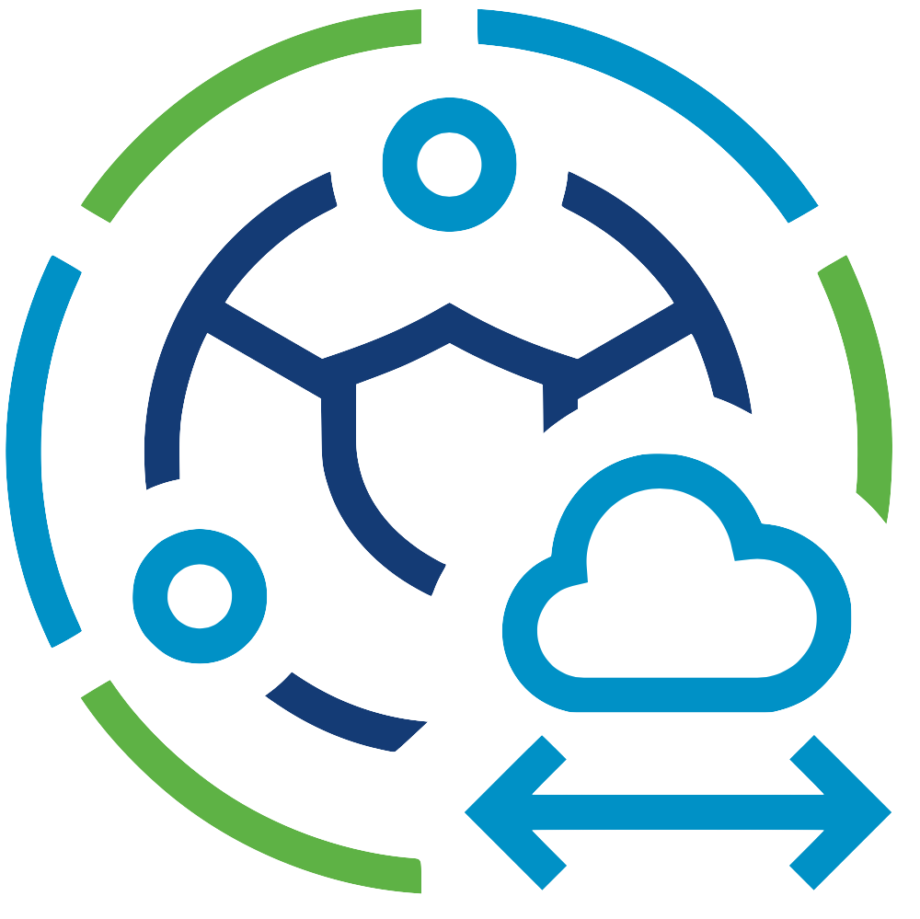
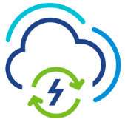

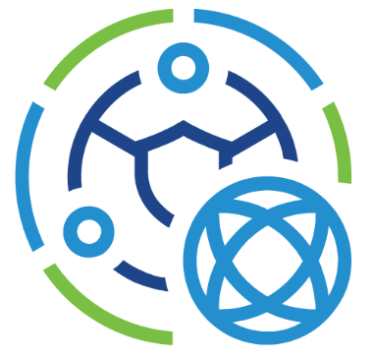

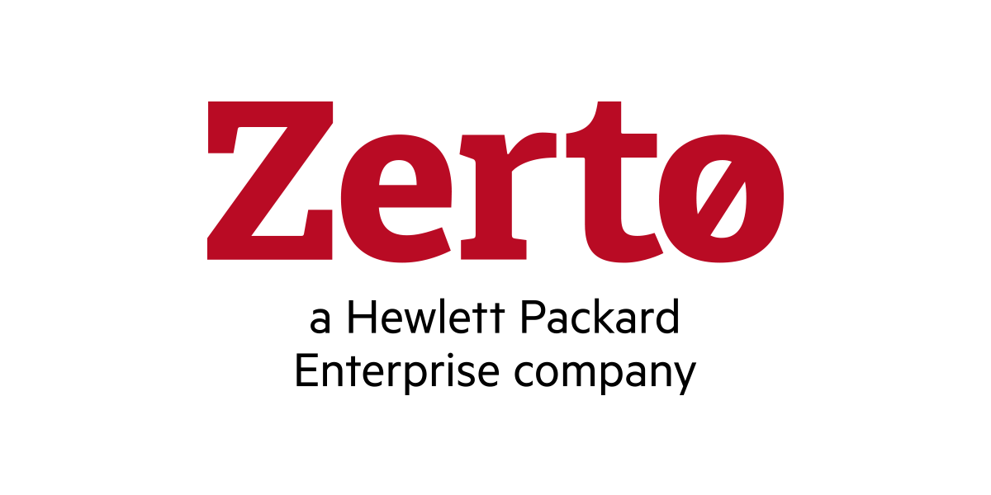
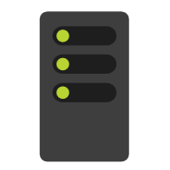



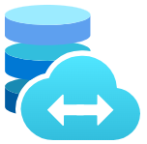
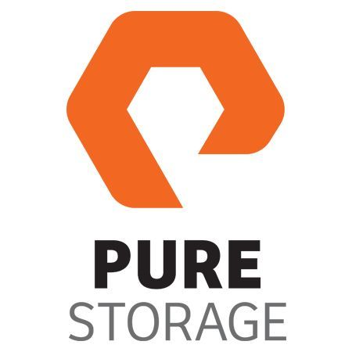
Microsoft Azure
Azure Subscription
Azure ExpressRoute
Dedicated Microsoft
Enterprise Edge
Azure Region
Azure Virtual Network
Azure Virtual WAN
Azure Resource Group
Azure Route Server
Azure Virtual Network
Gateway
Azure VMware Solution
Private Cloud
VMware HCX
VMware SRM
Azure VMware Solution
Resource Cluster
Zerto DR
VMware
vCenter Server
VMware NSX
JetStream
DR
Azure Bare-Metal
ESXi hosts
VMware
vSAN Datastore
Azure Bare-Metal
ESXi hosts
VMware
vSAN Datastore
Azure NetApp Files
Azure Elastic SAN
Pure Cloud Block Store
Figure 3 – Azure VMware Solution Architectural Components

Slide 5



Microsoft Azure
Single AZ in an Azure Region
Single Azure Subscription
Primary Site vSphere
Environment (On-Prem,
Co-Lo, or Cloud-based)
Azure VMware Solution
Private Cloud (DR)
Gold SLA Apps
Gold SLA Apps
VMware SRM
Silver SLA Apps
Silver SLA Apps
Bronze SLA Apps
Bronze SLA Apps
Figure 4 – Azure VMware Solution Region for Disaster Recovery

Slide 6
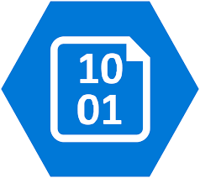
DR Azure VMware Solution private cloud “pilot light” cluster would be expanded after the DR event and Gold & Silver SLA applications recovered using DR Automation.
Primary Site vSphere
Environments (On-Prem,
Co-Lo, or Cloud-based)
Azure VMware Solution
Private Cloud (DR)
Gold SLA Apps
VMware SRM
Gold SLA Apps
Silver SLA Apps
Silver SLA Apps
Bronze SLA Apps
Azure Blob Storage used
by backup solution
Backup
Replication
Restore
Bronze SLA Apps
Bronze SLA applications would be restored from the 3rd party backup solution to the Bronze Azure VMware Solution private cloud.
Figure 5 – Azure VMware Solution DR Shared Services

Slide 7
Azure VMware Solution
Private Cloud (Gold SLA)
Primary Site vSphere
Environments (On-Prem,
Co-Lo, & Cloud-based)
Gold SLA Apps
VMware SRM
Silver SLA Azure VMware Solution private cloud “pilot light” cluster would be expanded after the DR event and Silver SLA applications recovered using DR Automation.
Azure VMware Solution
Private Cloud (Silver SLA)
Gold SLA Apps
Silver SLA Apps
VMware SRM
Silver SLA Apps
Azure Blob Storage used
by backup solution
Bronze SLA Azure VMware Solution private cloud would be built after the DR event occurred and Bronze SLA applications would be restored from the 3rd party backup solution to the Bronze Azure VMware Solution private cloud.
Bronze SLA Apps
Backup
Replication
Bronze SLA Apps
Azure VMware Solution
Private Cloud (Bronze SLA)
Restore
Figure 6 – Azure VMware Solution Dedicated DR Pods

Slide 8
Microsoft Azure
Primary Site vSphere Environment (On-Prem, Co-Lo, or Cloud-based)
Protected Site
Azure VMware Solution
Private Cloud (DR)
Recovery Site
VMware
vCenter Server
Bare-Metal
ESXi hosts
Azure Bare-Metal
ESXi hosts
VMware
vCenter Server
Registered
SRM Site Pair
Registered
Paired
VMware SRM
VMware SRM
Paired
vSphere
Replication
Managed
Managed
VMware vSphere
Replication Manager
VMware vSphere
Replication Server
VMware vSphere
Replication Server
VMware vSphere
Replication Manager
SRM Protection
Groups &
Recovery Plans
Gold SLA Apps
Silver SLA Apps
Bronze SLA Apps
Gold SLA Apps
Silver SLA Apps
Bronze SLA Apps
Figure 7 – Azure VMware Solution with VMware Site Recovery Manager

Slide 9
Microsoft Azure
Primary Site vSphere Environment (On-Prem, Co-Lo, or Cloud-based)
Protected Site
Azure VMware Solution
Private Cloud (DR)
Recovery Site
Bare-Metal
ESXi hosts
VMware
vCenter Server
VMware
vCenter Server
Azure Bare-Metal
ESXi hosts
Registered
Zerto Site Pair
Registered
1:1 Paired
1:1 Paired
Managed
Zerto Virtual
Manager
(ZVM)
Zerto Virtual
Manager
(ZVM)
Managed
Zerto
Replication
Zerto Virtual
Replication
Appliances (ZVRAs)
Zerto Virtual
Replication
Appliances (ZVRAs)
Zerto Virtual
Protection Groups
(VPGs)
Gold SLA Apps
Silver SLA Apps
Bronze SLA Apps
Gold SLA Apps
Silver SLA Apps
Bronze SLA Apps
Figure 8 – Azure VMware Solution with Zerto DR

Slide 10
Microsoft Azure
JetStream
Replication
Azure Blob Storage
Primary Site vSphere Environment (On-Prem, Co-Lo, or Cloud-based)
Protected Site
Azure VMware Solution
Private Cloud (DR)
Recovery Site
Bare-Metal
ESXi hosts
VMware
vCenter Server
VMware
vCenter Server
Azure Bare-Metal
ESXi hosts
IO Filter
Registered
Registered
IO Filter
Managed
Managed
JetStream DR
Virtual
Appliance
(DRVA)
JetStream Manager
Virtual
Appliance
(MSA)
JetStream Manager
Virtual
Appliance
(MSA)
JetStream DR
Virtual
Appliance
(DRVA)
JetStream
Protected Domain
Gold SLA Apps
Silver SLA Apps
Bronze SLA Apps
Gold SLA Apps
Silver SLA Apps
Bronze SLA Apps
Figure 9 – Azure VMware Solution with JetStream DR

Slide 11
Microsoft Azure
Primary Site vSphere Environment (On-Prem, Co-Lo, or Cloud-based)
Protected Site
Azure VMware Solution
Private Cloud (DR)
Recovery Site
VMware
vCenter Server
Bare-Metal
ESXi hosts
Azure Bare-Metal
ESXi hosts
VMware
vCenter Server
HCX Service Mesh
Registered
Registered
VMware HCX
VMware HCX
HCX DR Replication
Gold SLA Apps
Silver SLA Apps
Bronze SLA Apps
Gold SLA Apps
Silver SLA Apps
Bronze SLA Apps
Figure 10 – Azure VMware Solution with VMware HCX Disaster Recovery

Slide 12
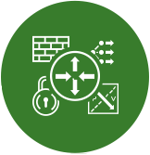
Microsoft Azure
Azure VMware Solution
Private Cloud
Azure ExpressRoute
Dedicated Microsoft
Enterprise Edge (D-MSEE)
Azure Dell
Bare-Metal
ESXi hosts
VMware
vSAN Datastore
VMware
vCenter Server
VMware NSX
Cluster-1 needs three AV36, AV36P, or AV52 nodes in a supported Azure region
VMware NSX
Edges
Azure Network Backbone
AV64 can be used for Clusters 2 to 12
Azure AV64
Bare-Metal
ESXi hosts
Figure 11 – AV64 Mixed SKU Topology

Slide 13
Microsoft Azure
Azure VMware Solution
Private Cloud
Primary Site vSphere
Environments (On-Prem,
Co-Lo, or Cloud-based)
Cluster-1
Gold SLA Apps
Web 1
Web 2
App 1
App 2
DB 1
DB 2
“Gold App 1” Recovery Plan
VMware SRM
Silver SLA Apps
Web 3
Web 4
App 3
App 4
DB 3
DB 4
Bronze SLA Apps
“Silver App 2” Recovery Plan
ESXi host 1
ESXi host 2
ESXi host 3
ESXi host 4
ESXi host 5
Figure 12 – VMware Site Recovery Application Recovery Plans

Slide 14
Microsoft Azure
Primary Site vSphere Environment (On-Prem, Co-Lo, or Cloud-based)
Protected Site
Azure VMware Solution
Private Cloud (DR)
Recovery Site
VMware
vCenter Server
Bare-Metal
ESXi hosts
Azure Bare-Metal
ESXi hosts
VMware
vCenter Server
Registered
SRM Site Pair
Registered
Paired
VMware SRM
VMware SRM
Paired
vSphere
Replication
Managed
Managed
VMware vSphere
Replication Manager
VMware vSphere
Replication Server
VMware vSphere
Replication Server
VMware vSphere
Replication Manager
SRM Protection
Groups &
Recovery Plans
Gold SLA Apps
Silver SLA Apps
Bronze SLA Apps
Gold SLA Apps
Silver SLA Apps
Bronze SLA Apps
VMware HCX
VMware HCX
Layer 2 Network Extension
Figure 13 – VMware HCX Layer 2 Network Extension with VMware Site Recovery

Slide 15
Microsoft Azure
Dual AZs in an Azure Region
Single Azure Subscription
AZ1 – Preferred Site
AZ2 – Secondary Site
Azure VMware Solution
Private Cloud A
Stretched vSAN Datastore
Azure Bare-Metal
ESXi hosts
VMware
vSAN Datastore
Preferred
Fault Domain
VMware
vCenter Server
VMware NSX
Azure Bare-Metal
ESXi hosts
VMware
vSAN Datastore
Secondary
Fault Domain
VMware NSX
Edge A
VMware HCX
Gold SLA Apps
VMware NSX
Edge B
Gold SLA Apps
Silver SLA Apps
Bronze SLA Apps
Policy-based Synchronous Replication
AZ3 – Witness Site
VMware vSAN
Witness Appliance
Figure 14 – Azure VMware Solution Private Cloud with Stretched Clusters

